Slide 1
An Introduction to Graph Theory
BY
DR. DALVINDER SINGH
GOVT. COLLEGE ROPAR

Slide 2
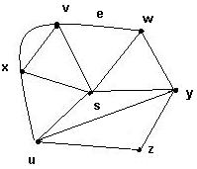
INTRODUCTION
What is a graph G?
It is a pair G = (V, E), where
  V = V(G) = set of vertices
  E = E(G) = set of edges
Example:
  V = {s, u, v, w, x, y, z}
  E = {(x,s), (x,v)₁, (x,v)₂, (x,u), (v,w),
  (s,v), (s,u), (s,w), (s,y), (w,y), (u,y), (u,z),(y,z)}

Slide 3
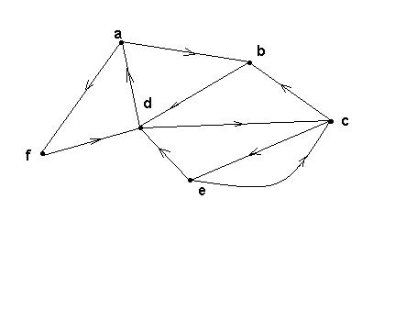
Directed graphs (digraphs)
G is a directed graph or digraph if each edge has been associated with an ordered pair of vertices, i.e. each edge has a direction

Slide 4
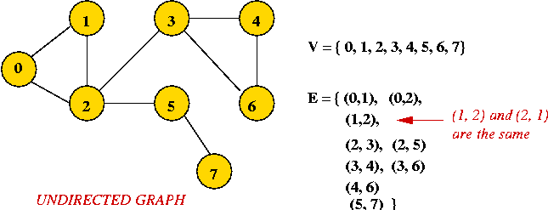
UNDIRECTED GRAPH
Edges have no direction.
If an edge connects vertices 1 and 2, either convention can be used:
  No duplication: only one of (1, 2) or (2, 1) is allowed in E.
  Full duplication: both (1, 2) and (2, 1) should be in E.

Slide 5
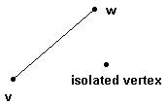
Edges
An edge may be labeled by a pair of vertices, for instance e = (v,w).
e is said to be incident on v and w.
Isolated vertex = a vertex without incident edges.

Slide 6
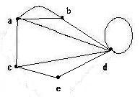
Special edges
Parallel edges
  Two or more edges
  joining a pair of vertices
    in the example, a and b
    are joined by two parallel
    edges
Loops
  An edge that starts
  and ends at the same vertex
  In the example, vertex d has a loop

Slide 7
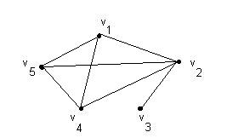
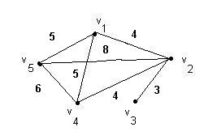
Special graphs
Simple graph
  A graph without loops
  or parallel edges.
Weighted graph
  A graph where each
  edge is assigned a
  numerical label
  or “weight”.

Slide 8
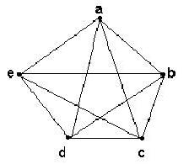
Complete graph K _{n}
Let n > 3
The complete graph K_{n}
is the graph with n vertices
and every pair of vertices
is joined by an edge.
The figure represents K₅
The degree of complete graph is n-1

Slide 9
FINITE AND INFINITE GRAPH
A graph G = ( V, E ) is called a finite graph if the vertex Set V is finite set.
A graph G = ( V, E ) is called an infinite graph if the vertex Set V is an infinite set.

Slide 10
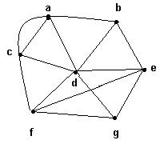
DEGREE OF THE VERTEX
The degree of a
vertex v, denoted by δ(v),
is the number of edges
incident on v
Example:
  δ(a) = 4, δ(b) = 3,
  δ(c) = 4, δ(d) = 6,
  δ(e) = 4, δ(f) = 4,
  δ(g) = 3.

Slide 11
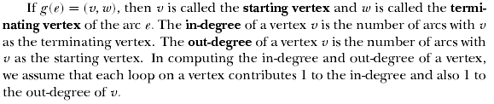
In degree and out degree

Slide 12
PENDENT VERTEX
A vertex whose degree in a graph is 1 is called the pendent vertex.
a
b ____________c
The vertices a and c are pendent vertex because their degree is 1

Slide 13
DEFINATION
A Regular graph is a graph in which each vertex has the same degree
K- Regular graph is a graph in which each vertex has the same degree equal to k

Slide 14
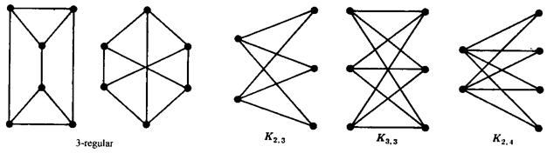
for example

Slide 15
Sum of the degrees of a graph
Theorem : If G is a graph with m edges and n vertices v₁, v₂,…, v_{n}, then
_{n}
Σ δ(v_{i}) = 2m
^{i = 1}
In particular, the sum of the degrees of all the vertices of a graph is even.

Slide 16
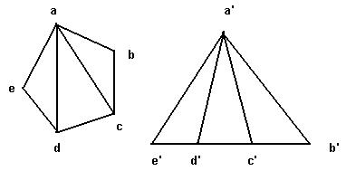
Isomorphic graphs
G₁ and G₂ are isomorphic
if there exist one-to-one onto functions f : V(G₁) → V(G₂) and g : E(G₁) → E(G₂) such that
an edge e is adjacent to vertices v, w in G₁ if and only if g(e) is adjacent to f(v) and f(w) in G₂

Slide 17
Isomorphic Graphs
In other words ,two graphs which are isomorphic will have
Same number of vertices
Same number of edges
An equal number of vertices with given degrees

Slide 18
Homeomorphic graphs
Two graphs G and G’ are said to be homeomorphic if G’ is obtained from G by a sequence of series reductions.
  By convention, G is said to be obtainable from itself by a series reduction, i.e. G is homeomorphic to itself.
Define a relation R on graphs: GRG’ if G and G’ are homeomorphic.
R is an equivalence relation on the set of all graphs.

Slide 19
SUB GRAPH
Let G and H be two graphs with vertex sets V(H),V(G) and edge sets E(H) and E(G) respectively such that V(H) is contained in V(G) and E(H) is contained in E(G) , then we call H as a Subgraph of G ( or G as a supergraph of H )

Slide 20
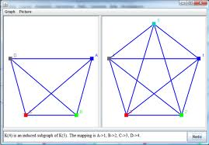
EXAMPLE

Slide 21
G-V GRAPH
G-V is a subgraph of G obtained by deleting the vertex V from the vertex set V(G) and deleting all the edges in E(G)which are incident on V
REMARK:
Every graph is its own subgraph
The null graph obtained from G by deleting all the edges of G is a subgraph of G

Slide 22
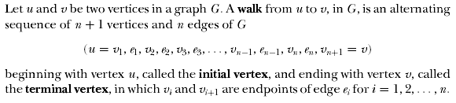
Walks, Paths, and Cycles

Slide 23
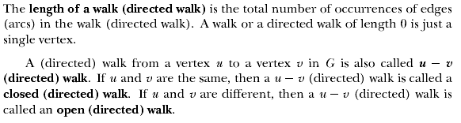
Length of Walk

Slide 24
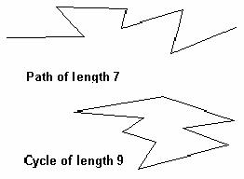
PATH , CYCLE
A path of length n is a sequence of n + 1 vertices and n consecutive edges
A cycle is a path that begins and ends at the same vertex

Slide 25

CONNECTED,DISCONNECTED GRAPHS AND COMPONENT

Slide 26
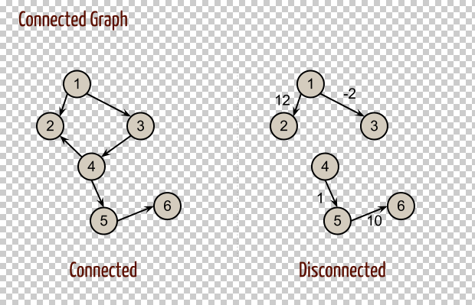
EXAMPLES

Slide 27
Euler graphs
An Euler cycle in a graph G is a simple cycle that passes through every edge of G only once.
A graph G is an Euler graph if it has an Euler cycle.
G is an Euler graph if and only if G is
connected and all its vertices have even degree.

Slide 28
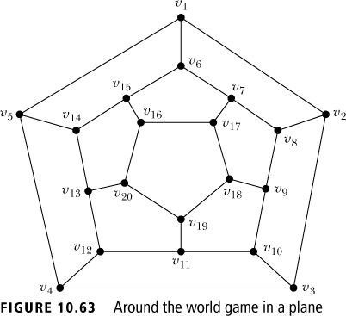
Hamiltonian cycles
Traveling salesperson problem
  To visit every vertex of a graph G only once by a simple cycle.
  Such a cycle is called a Hamiltonian cycle.
  If a connected graph G has a Hamiltonian cycle, G is called a Hamiltonian graph.

Slide 29
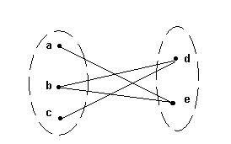
Bipartite graphs
A bipartite graph G is a graph such that
  V(G) = V(G₁) ∪ V(G₂)
  |V(G₁)| = m, |V(G₂)| = n
  V(G₁) ∩V(G₂) = ∅
  No edges exist between any two vertices in the same subset V(G_{k}), k = 1,2

Slide 30
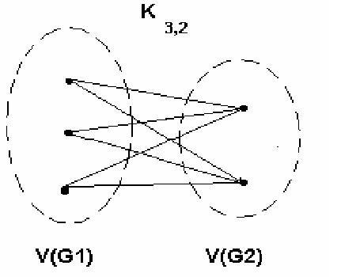
Complete bipartite graph K_{m,n}
A bipartite graph is the complete bipartite graph K_{m,n} if every vertex in V(G₁) is joined to a vertex in V(G₂) and conversely,
|V(G₁)| = m
|V(G₂)| = n

Slide 31
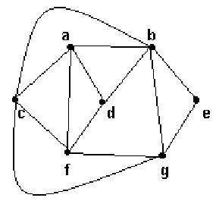
Planar graphs
A graph (or multigraph) G is called planar if G can be drawn in the plane with its edges intersecting only at vertices of G.
Such a drawing of G is called an embedding of G in the plane.

Slide 32
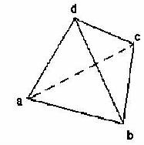
Euler’s formula
If G is planar graph,
  v = number of vertices
  e = number of edges
  f = number of faces, including the exterior face
Then: v – e + f = 2

Slide 33
Representations of graphs
Adjacency matrix
  Rows and columns are labeled with ordered vertices
  write a 1 if there is an edge between the row vertex and the column vertex
  and 0 if no edge exists between them

Slide 34
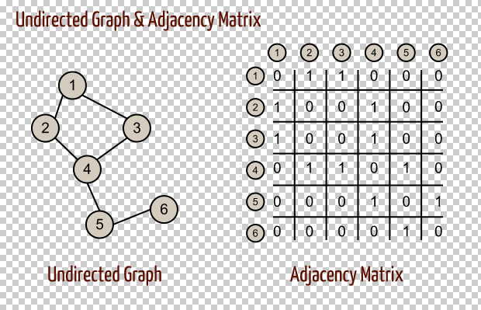
EXAMPLE

Slide 35
Incidence matrix
Incidence matrix
  Label rows with vertices
  Label columns with edges
  1 if an edge is incident to a vertex, 0 otherwise

Slide 36
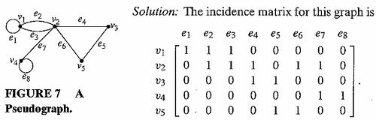
INCIDENCE GRAPH

Slide 37
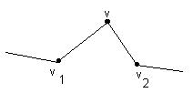
Edges in Series
Edges in series:
If v ∈ V(G) has degree 2 and there are edges (v, v₁), (v, v₂) with v₁ ≠ v₂,
we say the edges (v, v₁) and (v, v₂) are in series.

Slide 38
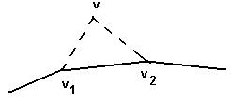
Series Reduction
A series reduction consists of deleting the vertex v ∈ V(G) and replacing the edges (v,v₁) and (v,v₂) by the edge (v₁,v₂)
The new graph G’ has one vertex and one edge less than G and is said to be obtained from G by series reduction

Slide 39
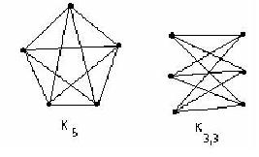
Kuratowski’s theorem
G is a planar graph if and only if G does not contain a subgraph homeomorphic to either K ₅ or K _{3,3}

Slide 40
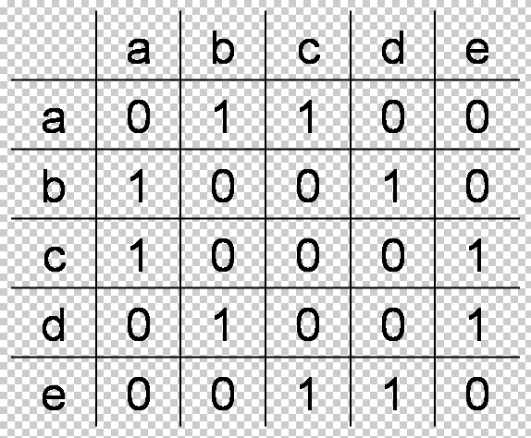
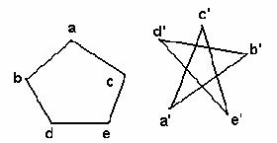
Isomorphism and adjacency matrices
Two graphs are isomorphic if and only if
after reordering the vertices their adjacency matrices are the same

Slide 41
THE END
THANKS

